Slide 1
Nanoscale thermal transport
Lecture 1
Riley Hanus
http://rileyhanus.com/science.html

Slide 2
Two rules
Use your imagination
You should be actively building a picture in your head.
I’ll do my best to provide good pictures, but the pictures will fall short.
2. Don’t be afraid of the math
It’s (almost) impossible to know every bit of math that is thrown at you.
You will need to learn math as you go.
All math can be learned, it just might take some patience.

Slide 3
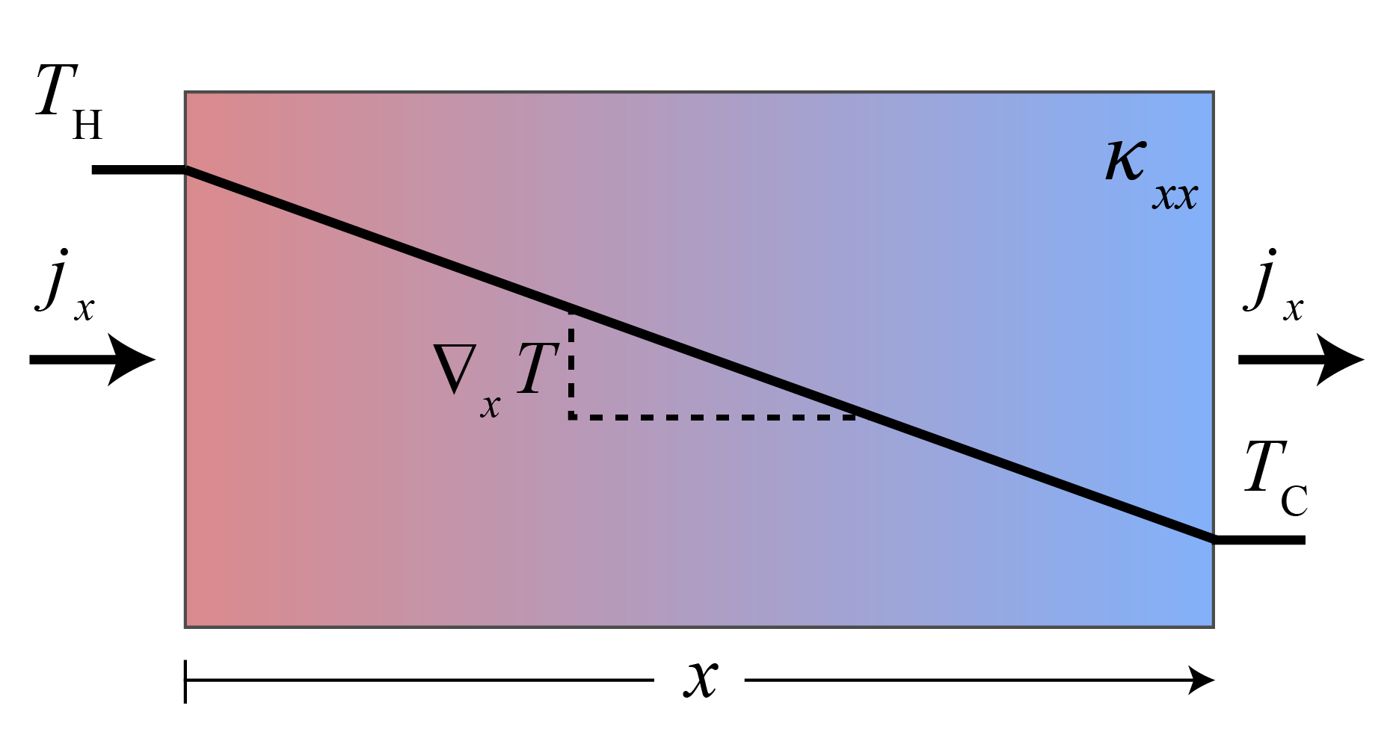
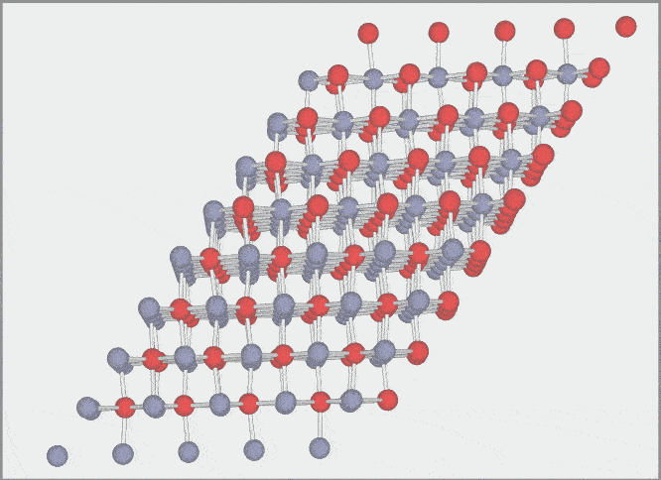
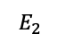
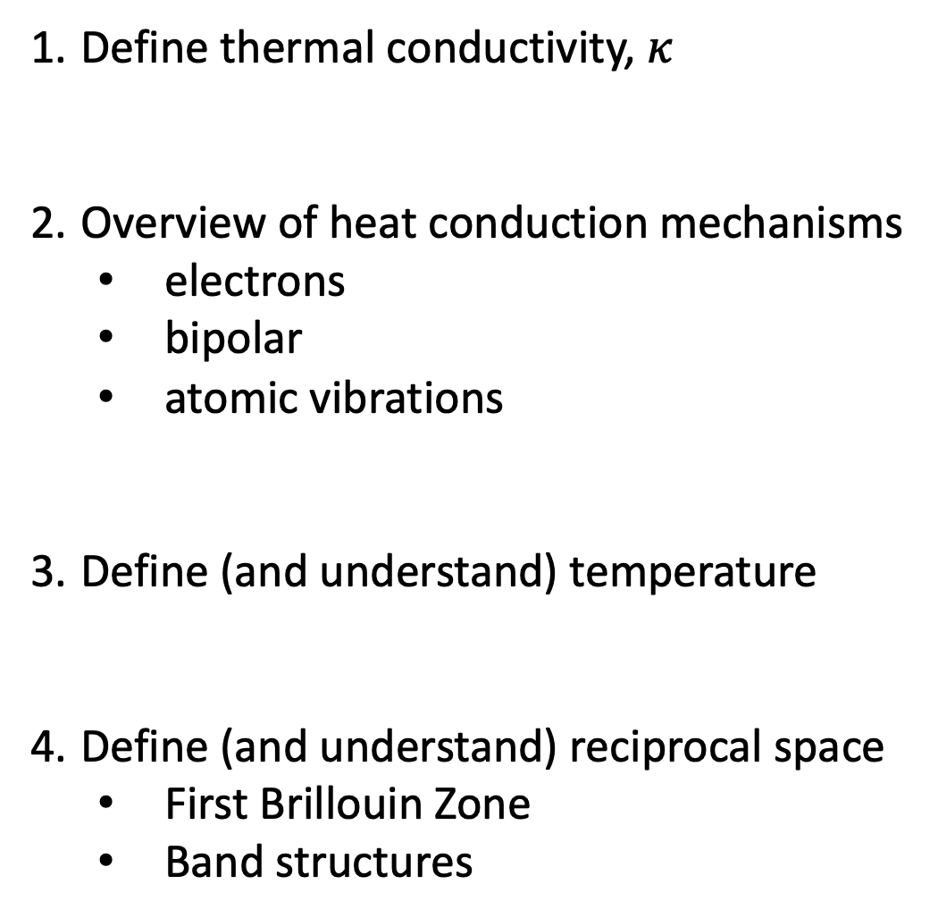
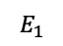
Define thermal conductivity, $κ$
Overview of heat conduction mechanisms
electrons
bipolar
atomic vibrations
Define (and understand) temperature
Define (and understand) reciprocal space
First Brillouin Zone
Band structures
600K
$$E_{1}$$
$$E_{2}$$

Slide 5
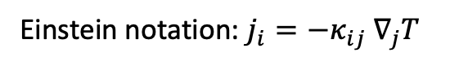
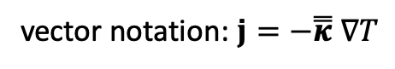
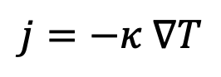
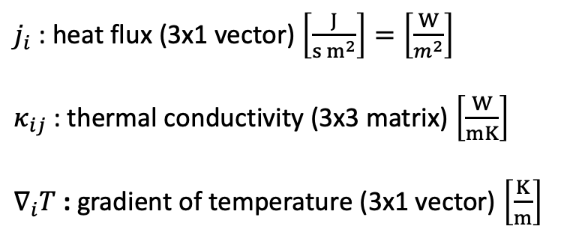
Fourier’s Law
$$j=−κ ∇T$$
Let’s be explicit:
$j_{i}$ : heat flux (3x1 vector) $\left[\frac{J}{s{ m}^{2}}\right]=\left[\frac{W}{m^{2}}\right]$
$κ_{ij}$: thermal conductivity (3x3 matrix) $\left[\frac{W}{mK}\right]$
$∇_{i}T$ : gradient of temperature (3x1 vector) $\left[\frac{K}{m}\right]$
vector notation: $j=−\overset{̿}{κ} ∇T$
Einstein notation: $j_{i}=−κ_{ij} ∇_{j}T$

Slide 6
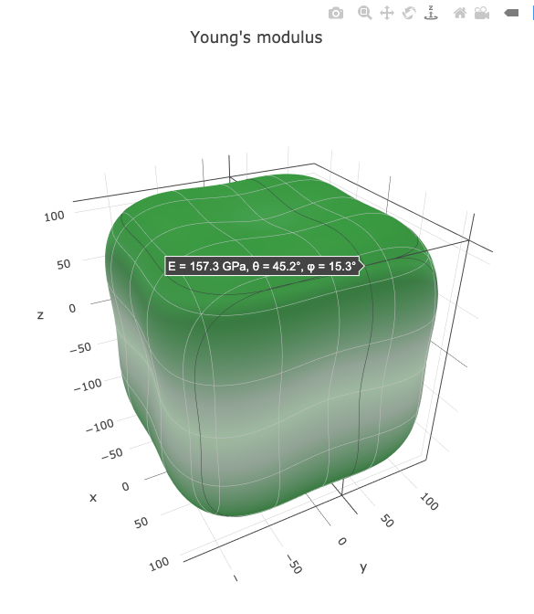
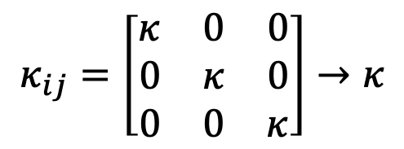
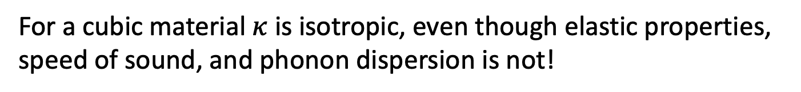
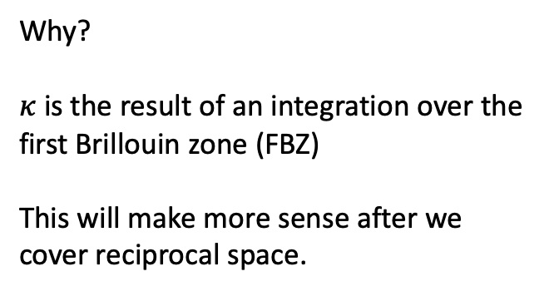
For a cubic material $κ$ is isotropic, even though elastic properties, speed of sound, and phonon dispersion is not!
$$κ_{ij}=\left[\begin{matrix}κ & 0 & 0 \\ 0 & κ & 0 \\ 0 & 0 & κ\end{matrix}\right]→κ$$
Young’s Modulus contour of Si from Materials Project
Why?
$κ$ is the result of an integration over the first Brillouin zone (FBZ)
This will make more sense after we cover reciprocal space.

Slide 7
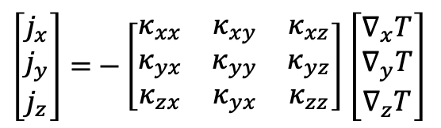
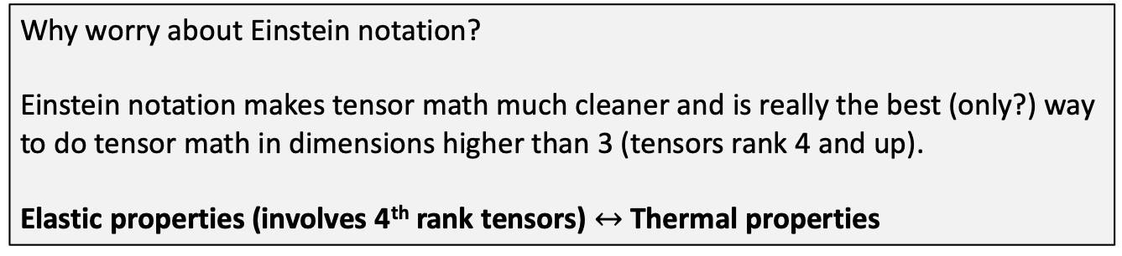
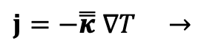
Einstein (index) notation
Rule: sum over repeated indices in a term, sometimes called a ‘dummy’ index
$$j_{i}=−κ_{ij} ∇_{j}T=−(κ_{ix}∇_{x}T+κ_{iy}∇_{y}T+κ_{iz}∇_{z}T)$$
$\left[\begin{matrix}j_{x} \\ j_{y} \\ j_{z}\end{matrix}\right]=$ $−\left[\begin{matrix}κ_{xx} & κ_{xy} & κ_{xz} \\ κ_{yx} & κ_{yy} & κ_{yz} \\ κ_{zx} & κ_{yx} & κ_{zz}\end{matrix}\right]$ $\left[\begin{matrix}∇_{x}T \\ ∇_{y}T \\ ∇_{z}T\end{matrix}\right]$
$j=−\overset{̿}{κ} ∇T →$
Why worry about Einstein notation?
Einstein notation makes tensor math much cleaner and is really the best (only?) way to do tensor math in dimensions higher than 3 (tensors rank 4 and up).
Elastic properties (involves 4th rank tensors) $↔$ Thermal properties

Slide 8
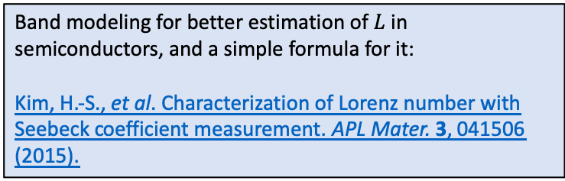
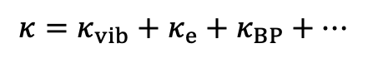
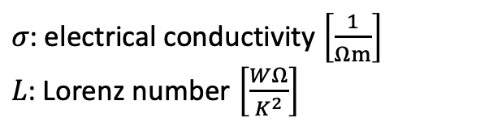
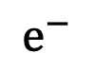
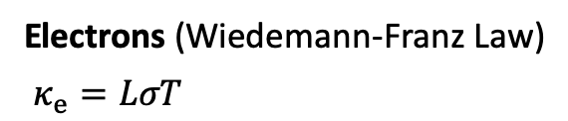
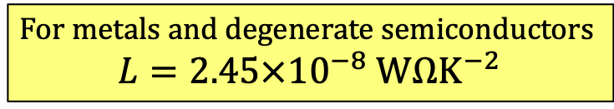
What conducts heat?
$$κ=κ_{vib}+κ_{e}+κ_{BP}+…$$
Electrons (Wiedemann-Franz Law)
$κ_{e}=LσT$
$σ$: electrical conductivity $\left[\frac{1}{Ωm}\right]$
$L$: Lorenz number $\left[\frac{WΩ}{K^{2}}\right]$
For metals and degenerate semiconductors
$$L=2.45×{10}^{−8} WΩK^{−2}$$
$$e^{−}$$
Depends on electronic band structure
Varies in semiconductors, but typically no more than 20%
This value held for doped, metallic like conducting polymer PEDOT:PSS
Weird things happening in VO₂
Band modeling for better estimation of $L$ in semiconductors, and a simple formula for it:
Kim, H.-S., et al. Characterization of Lorenz number with Seebeck coefficient measurement. APL Mater. 3, 041506 (2015).
Note:
(worth remembering)

Slide 9
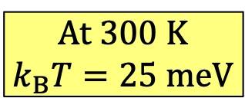
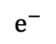
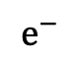
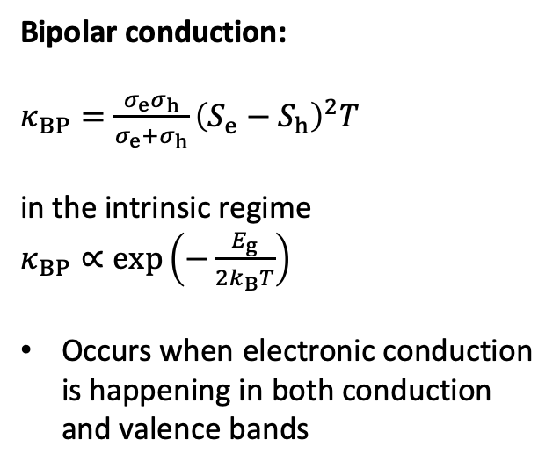
What conducts heat?
$$κ=κ_{vib}+κ_{e}+κ_{BP}+…$$
Bipolar conduction:
$κ_{BP}=\frac{σ_{e}σ_{h}}{σ_{e}+σ_{h}}{\left(S_{e}−S_{h}\right)}^{2}T$
in the intrinsic regime
$κ_{BP}∝\exp\left(−\frac{E_{g}}{2k_{B}T}\right)$
Occurs when electronic conduction is happening in both conduction and valence bands
$$e^{−}$$
$$e^{−}$$
Absorb heat
Release heat
At 300 K
$k_{B}T=25 meV$
Paper discussing bipolar thermal conductivity, lots of good references:
Bahk, J. H. & Shakouri, A. Appl. Phys. Lett. 105, 6–11 (2014).

Slide 10
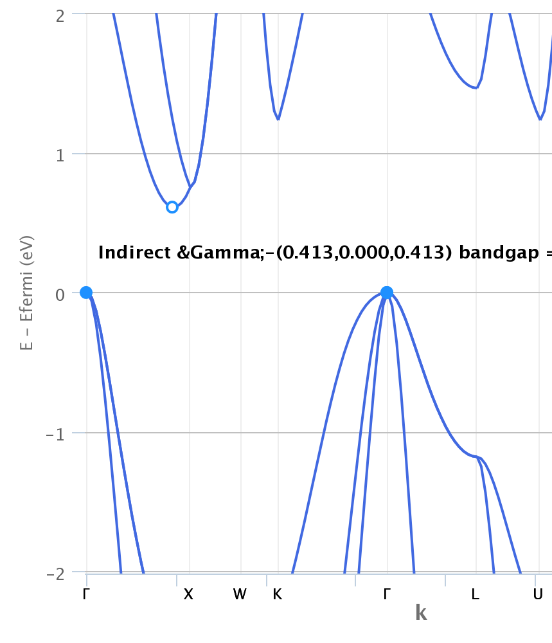
Aside: Electronic band structure of Si from DFT, Materials Project
Anything wrong?
Si bandgap is 1.1 eV
DFT usually gets the band gap wrong

Slide 11
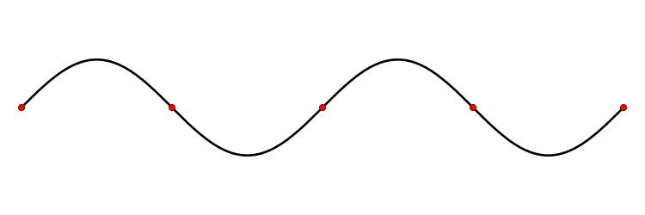
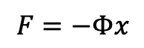
What conducts heat?
$$κ=κ_{vib}+κ_{e}+κ_{BP}+…$$
Atomic vibrations:
Interatomic force constants (IFCs)
think ball and spring
$$F=−Φx$$
IFCs atomic masses structure
normal modes of vibration
Phonons!

Slide 12
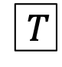
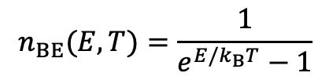
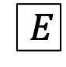
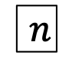
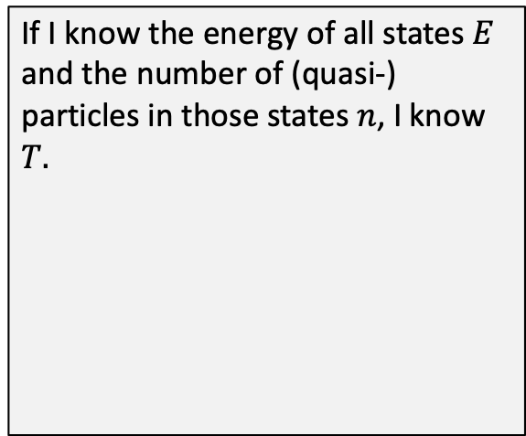
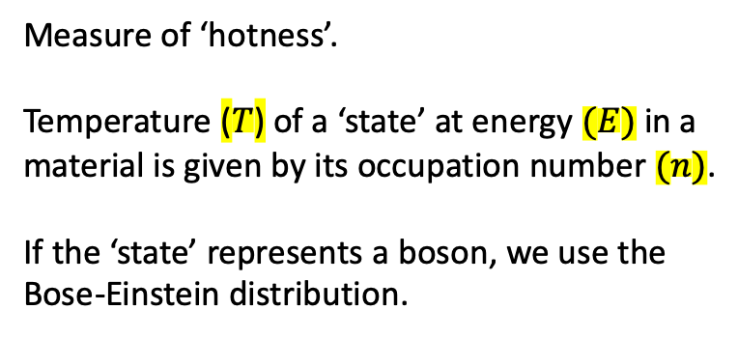
What is temperature?
Measure of ‘hotness’.
Temperature ($T$) of a ‘state’ at energy $(E)$ in a material is given by its occupation number $(n)$.
If the ‘state’ represents a boson, we use the Bose-Einstein distribution.
$$n_{BE}(E,T)=\frac{1}{e^{E/k_{B}T}−1}$$
If I know the energy of all states $E$ and the number of (quasi-) particles in those states $n$, I know $T.$
$$n$$
$$T$$
$$E$$

Slide 13
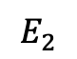
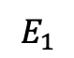
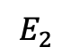
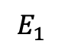
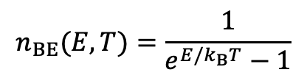
Diffuse
What is temperature?
$$n_{BE}(E,T)=\frac{1}{e^{E/k_{B}T}−1}$$
600K
300 K
sufficient coupling between states
$$E_{1}$$
$$E_{2}$$
$$E_{1}$$
$$E_{2}$$
Coupling → phonon lifetime, relaxation time, mean free path

Slide 14
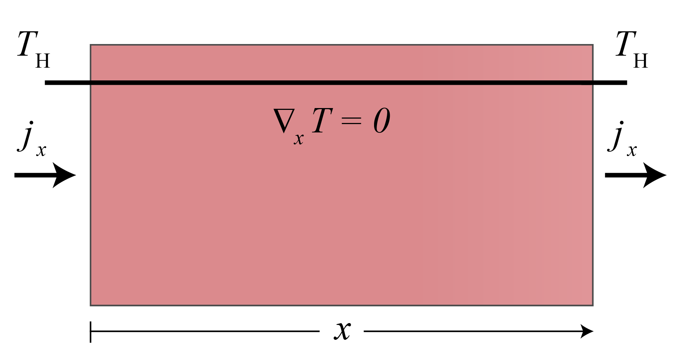
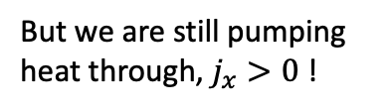
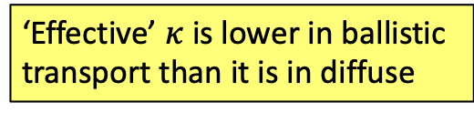
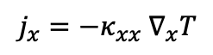
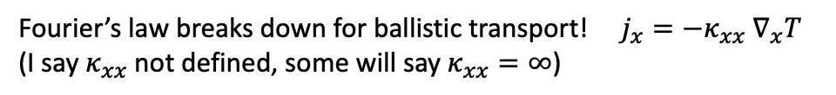
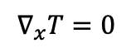
Ballistic
What is temperature?
$$j_{x}=−κ_{xx} ∇_{x}T$$
What’s going on?
$$∇_{x}T=0$$
But we are still pumping heat through, $j_{x}>0$ !
600K
600 K
$$E_{1}$$
$$E_{2}$$
$$E_{1}$$
$$E_{2}$$
Fourier’s law breaks down for ballistic transport! $j_{x}=−κ_{xx} ∇_{x}T$
(I say $κ_{xx}$ not defined, some will say $κ_{xx}=∞$)
‘Effective’ $κ$ is lower in ballistic transport than it is in diffuse

Slide 15
Reciprocal space
k-space
Why do we work in reciprocal space?
Once you see its Fourier transform in reciprocal space? MAYBE
Can you tell me what this waveform sounds like? NO
It’s more natural to examine waves in reciprocal space.

Slide 16
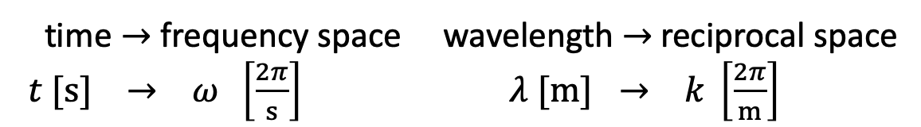
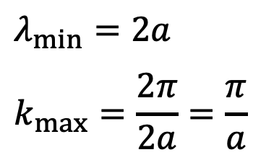
Reciprocal space
k-space
Let’s apply the same concept to a crystal
time $→$ frequency space wavelength $→$ reciprocal space
$t [s] → ω \left[\frac{2π}{s}\right]$ $λ [m] → k \left[\frac{2π}{m}\right]$
Start in 1D
a
(lattice parameter)
The crystal structure will set a minimum $λ$, or a maximum $k$
$$λ_{min}=2a$$
$$k_{max}=\frac{2π}{2a}=\frac{π}{a}$$
2a

Slide 17
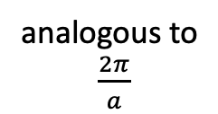
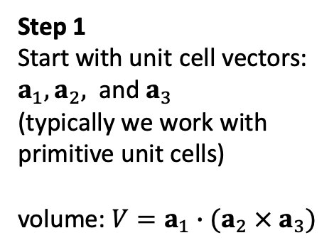


Reciprocal space
k-space
Defining the First Brillouin Zone, FBZ
(pronounced BREE – you – on with a soft ‘n’, its French)
See Kittle, Introduction to Solid State Physics, pg. 26 to 41
Step 1
Start with unit cell vectors:
$a_{1}, a_{2},$ and $a_{3}$
(typically we work with primitive unit cells)
volume: $V=a_{1}∙(a_{2} × a_{3})$
Step 2
Define reciprocal lattice vectors:
$b_{1}=\frac{2π}{V}(a_{2} × a_{3})$, $b_{2}=\frac{2π}{V}(a_{3} × a_{1})$, $b_{3}=\frac{2π}{V}(a_{1} × a_{2})$
Step 3
Draw planes halfway between each reciprocal lattice point
analogous to
$\frac{2π}{a}$
FCC
$k_{max}=\frac{π}{a}$
Note: be mindful of your $2π$’s. Some define k-space with $2π$, a lot of codes don’t.

Slide 18

Reciprocal space
k-space
Defining the First Brillouin Zone, FBZ
Step 4
Give certain k-points fancy names
Step 5
Walk from point to point and map energies of phonons, or electrons
https://www.cryst.ehu.es/
You can think of a phonon band structure (roughly) as the Fourier transform of the interatomic spring constants, weighted by the atomic masses.
What’s the wavelength at $Γ$? What about X?

Slide 19
Phonon band structures
Most solid-state physics classes will derive an analytical dispersion for a 1D chain.
If you haven’t seen this, read Kittel, Intro. to Solid State physics Chapter 4.
Much of the intuition gained from the 1D case extends to 3D
The math for a 3D crystal, which is used to calculate real dispersion relations is given in:
Wallace, Thermodynamics of Crystals, Chapter 3.10.
Hanus, Thesis, Section 2.2.1 and Appendix B.
Here we will outline the procedure for computing phonon properties:
frequencies
eigenvectors
(mode shape)

Slide 20








Phonon band structures
Set up
Simply solve the equations of motion (Newton’s law)
$$−Φx=ma$$
$α,β$: atom label
$i, j$: direction
$$F=−Φx$$
$$F=ma$$
$$−\sum_{jβ}{Φ_{ij}^{αβ}}u_{j}^{β}=m^{α}{\ddot{u}}_{i}^{α}$$
$$β=2$$
$$j=x$$
$$α=1$$
$$i=x$$
We know $Φ_{ij}^{αβ}$ and $m^{α}$ ,
solve for $u_{i}^{α}$.
Databases for interatomic force constants (IFCs) $Φ_{ij}^{αβ}$:
Phonopy: http://phonondb.mtl.kyoto-u.ac.jp/
almaBTE: http://www.almabte.eu/index.php/database/

Slide 21









Phonon band structures
Expressing a function as a Fourier Series
1. Express $u_{i}^{α}$ as a Fourier Series
$$f\left(x\right)=\sum_{N=−∞}^{∞}{c_{N}e^{iNx}}$$
2. Solve equation of motion ($−Φx=ma$)
$$−\sum_{jβ}{Φ_{ij}^{αβ}}u_{j}^{β}=m^{α}{\ddot{u}}_{i}^{α}$$
2a. In solving we find its convenient to define the Dynamical Matrix
2b. Phonon ’eigenstates’ are the solutions you get when you diagonalize the Dynamical Matrix
$3n$ distinct $ω^{2}$ and $ε_{i}^{α}$
solutions
scalar
3n length vector
3n x 3n matrix
3n length vector

Slide 22






$n$ = # of atoms in unit cell
$$s=1, …, 3n$$
scalar
$3n$ length vector
$3n x 3n$ matrix
$3n$ length vector
$3n$ distinct $ω^{2}$ and $ε_{i}^{α}$ solutions

Slide 23
Phonon band structures
In practice
Find solutions (diagonalize the Dynamical Matrix)
Along special directions to plot
pretty band structures:
On a mesh to sample the entire Brillouin Zone, when we want transport properties of density of states:
Computational suites that do this:
phonopy: https://atztogo.github.io/phonopy/
almaBTE: http://www.almabte.eu/
shengBTE: http://www.shengbte.org/

Slide 24

Reading a phonon band structure
$3$ acoustic modes ($ω→0$ at $Γ$)
$3n−3$ optical modes ($ω≠0$ at $Γ$)
$n$ is the number of atoms in the unit cell
Ultrasound, speed of sound,
Elastic tensor and moduli,
Bulk modulus, Young’s modulus,
etc.

Slide 25







Reading a phonon band structure
Group velocity and phase velocity
$$v_{p}$$
$$v_{g}=\frac{dω}{dk}$$
$$v_{p}=\frac{ω}{k}$$
$$v_{p}$$
$$v_{g}$$
$$flux=energy density × velocity × number=\frac{Energy}{Area × time}$$
Phonon-gas model for heat flux:
$$j^{i}=\frac{1}{V}\sum_{ks}{ℏω(ks)} v_{g}^{i} n(ks)$$

Slide 26



Reading a phonon band structure
Effect of atomic mass and the
phonon band gap.
Cubic GaN
Cubic GaAs
25 meV
25 meV
$$200 cm^{−1}≈25 meV$$

Slide 27

Resources
https://www.cryst.ehu.es/
space-group symmetry
KVEC
type in space group # (FCC Si, Fd-3m, no. 227)
click Brillouin zone
Phonon simulation software and databases:
phonopy: https://atztogo.github.io/phonopy/
almaBTE: http://www.almabte.eu/
shengBTE: http://www.shengbte.org/

